Slide 1
How Junior Engineers Can Utilize ChatGPT
國泰世華銀行 Samuel Luo
samuelluo1.work@gmail.com

Slide 2
Content
Introduction to ChatGPT
Examples of using ChatGPT
Summarize

Slide 3

Introduction to ChatGPT
此相片 (作者: 未知的作者) 已透過 CC BY-SA-NC 授權

Slide 4
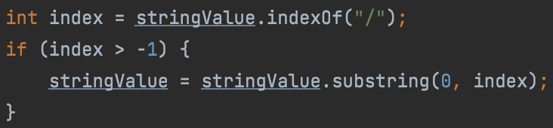
Ex1. Unfamiliar with Java
？
？
？

Slide 5
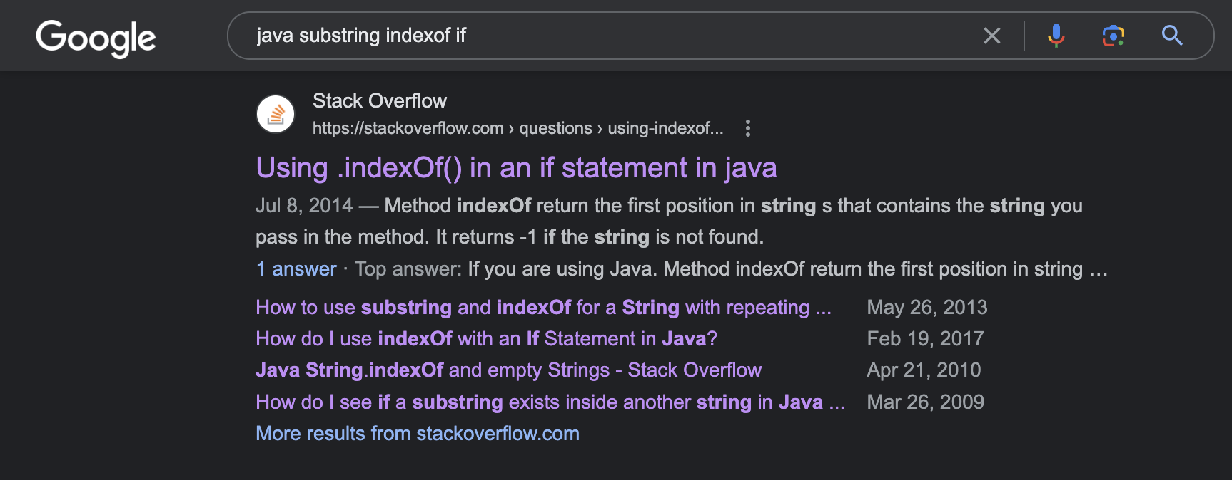
Ex1. Unfamiliar with Java
If just using Google…

Slide 6
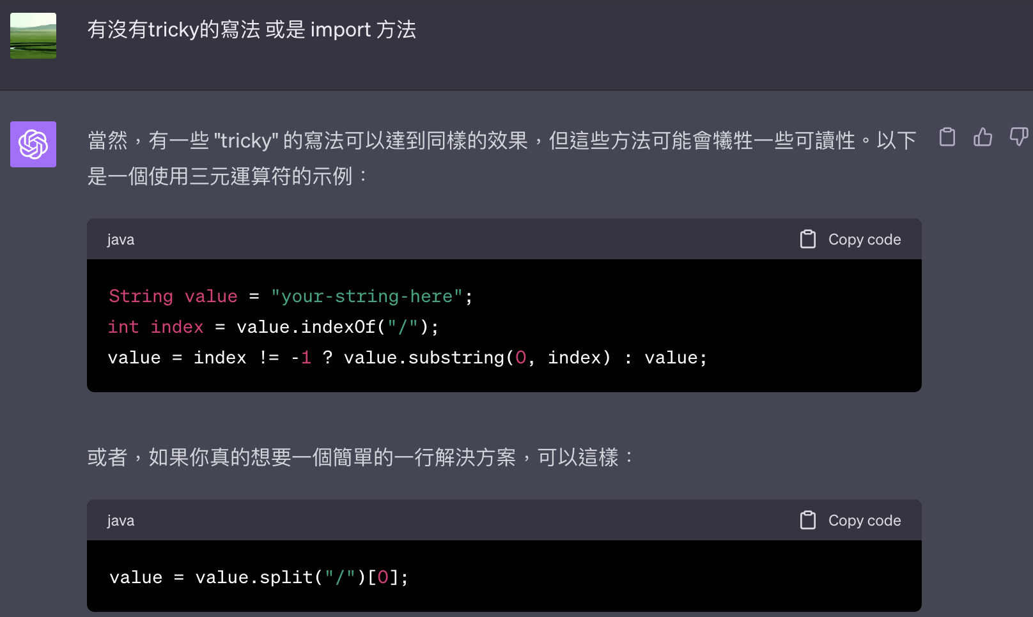
Ex1. Unfamiliar with Java

Slide 7
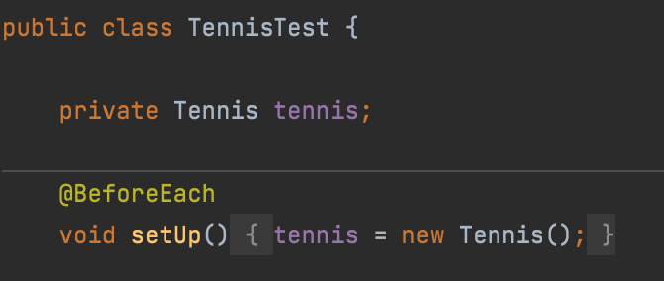
Ex2. Unfamiliar with JUnit

Slide 8
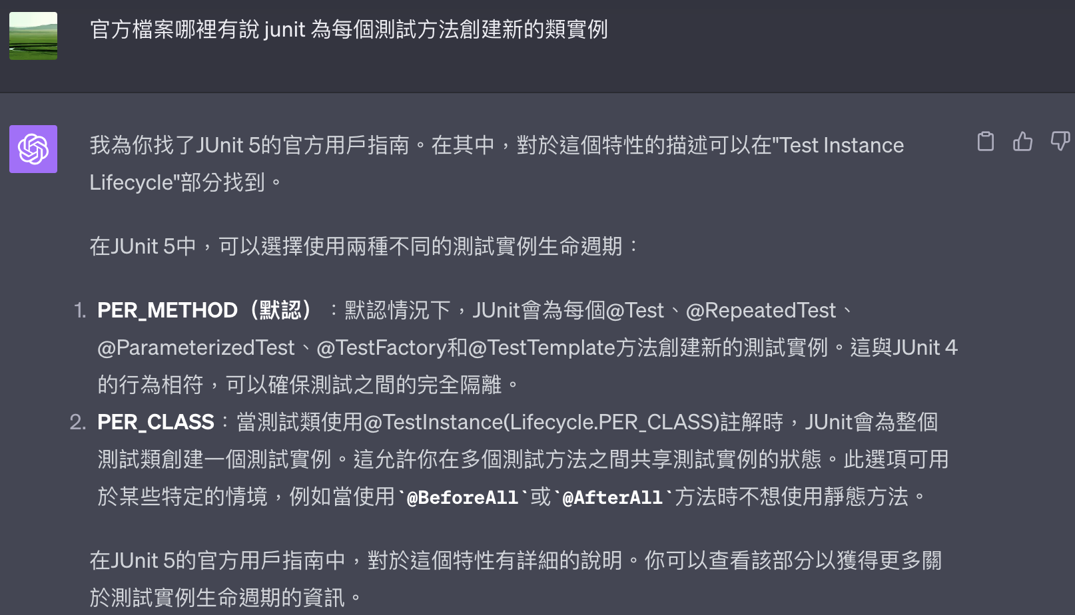
Ex2. Unfamiliar with JUnit

Slide 9
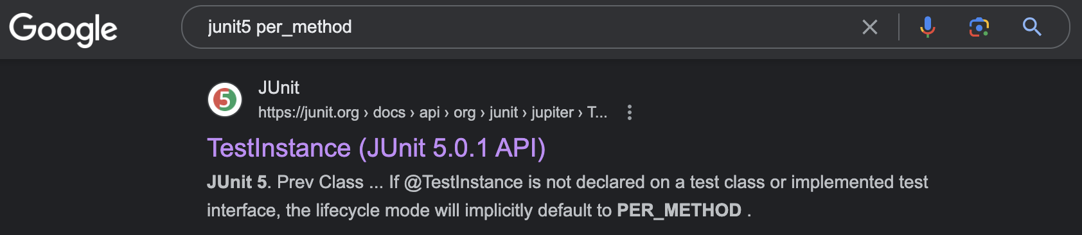
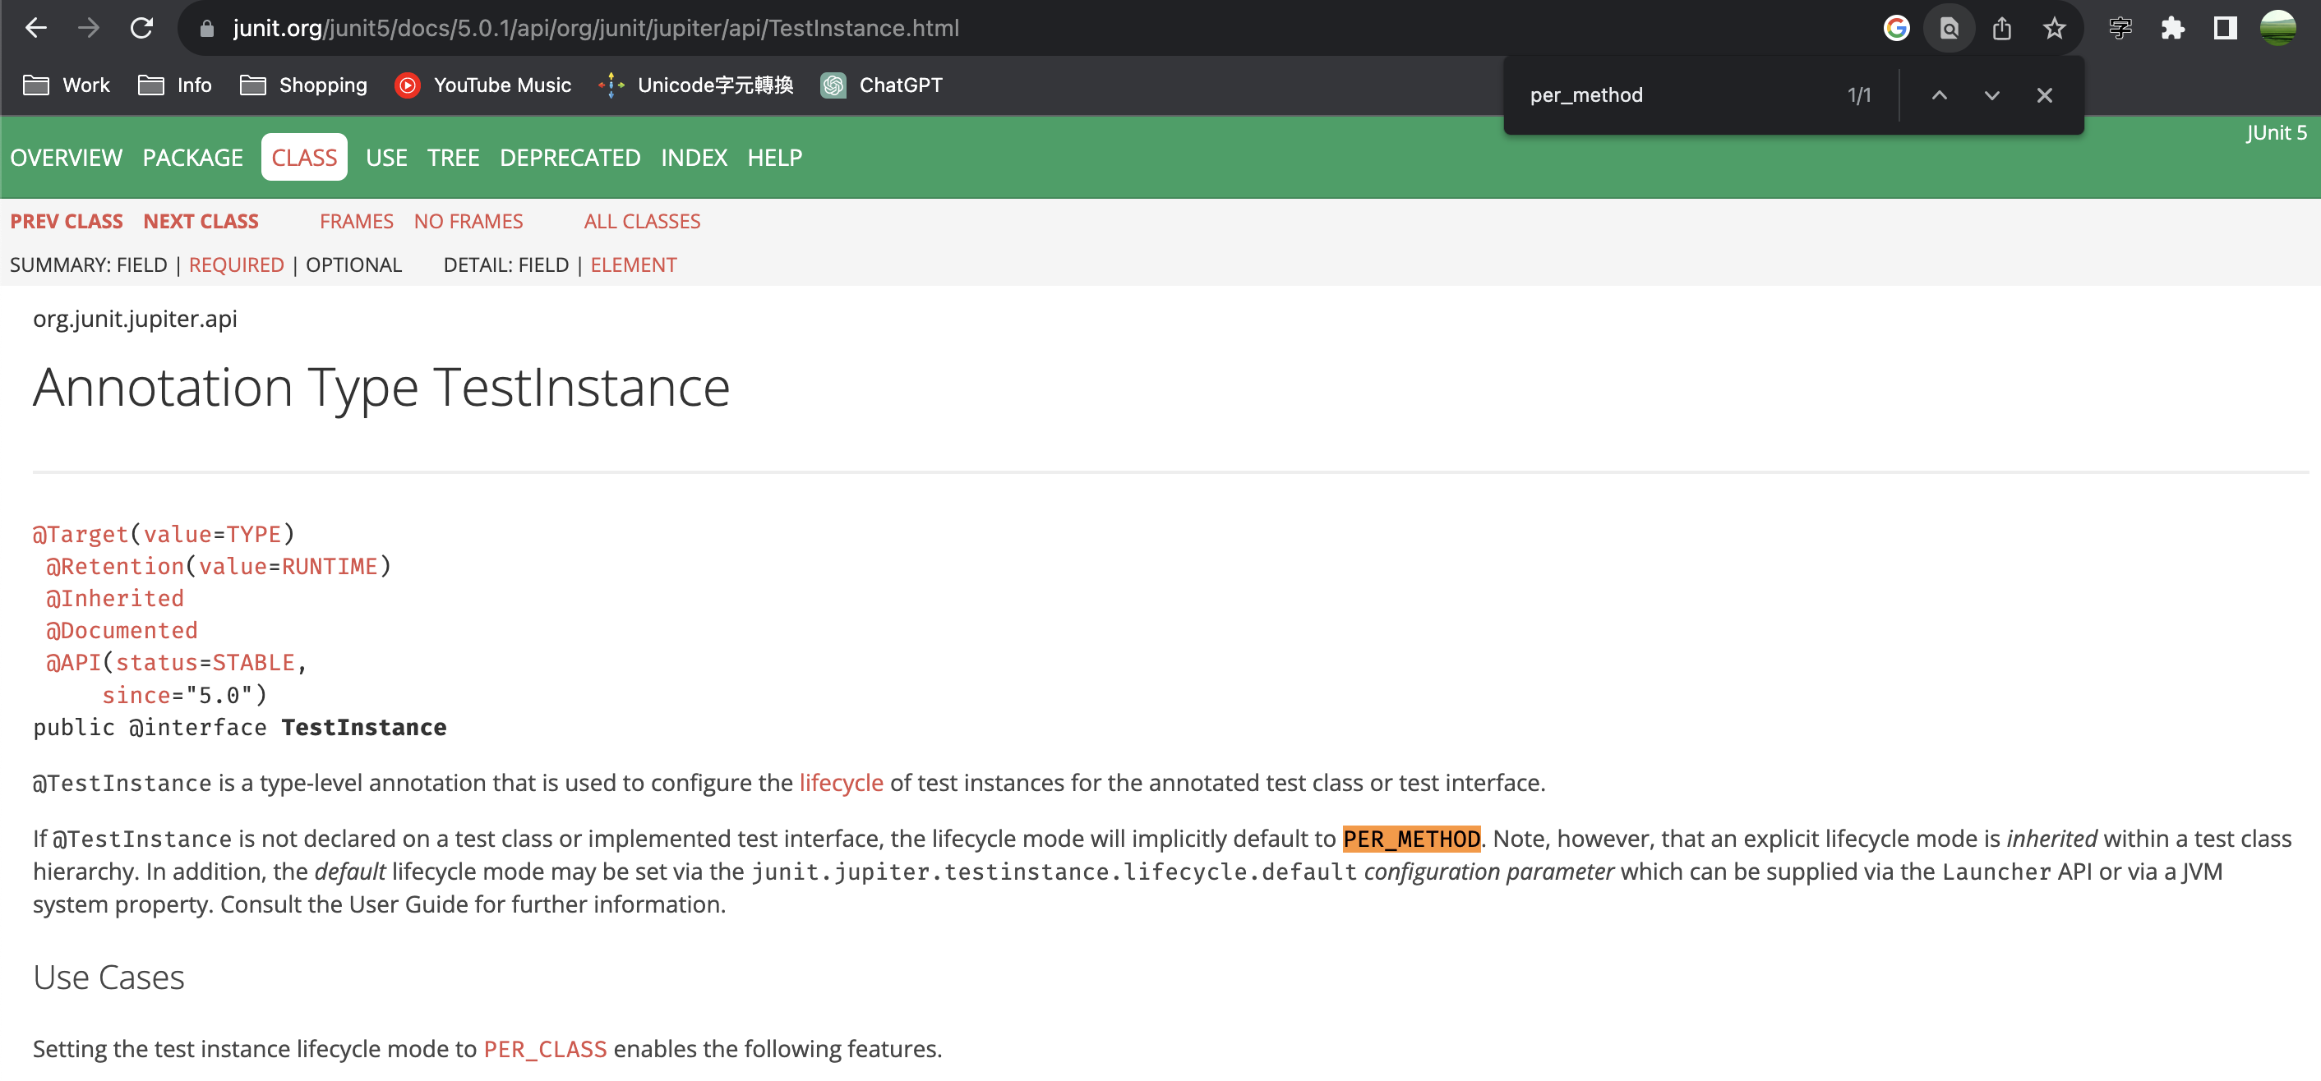
Ex2. Unfamiliar with JUnit

Slide 10
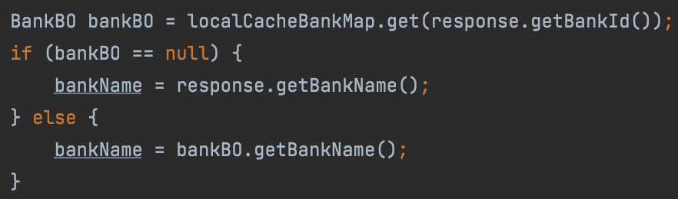
Ex3. Improve Coding Style

Slide 11
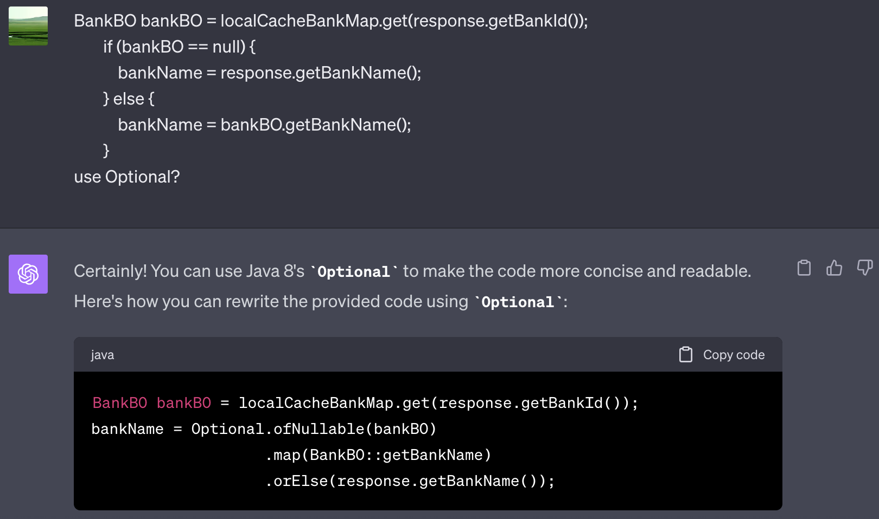
Ex3. Improve Coding Style

Slide 12
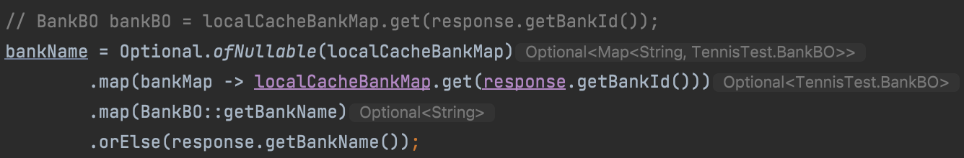
Ex3. Improve Coding Style

Slide 13
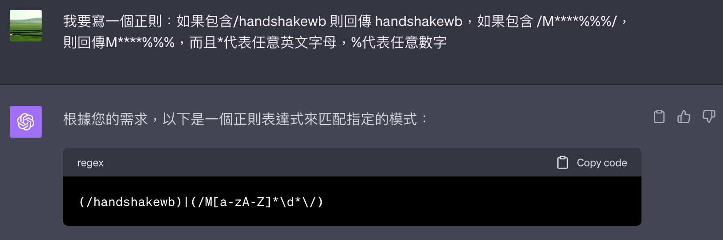
Ex3. Regex
(/handshakewb)|(/M[A-Z]{4}\\d{3}/)

Slide 14
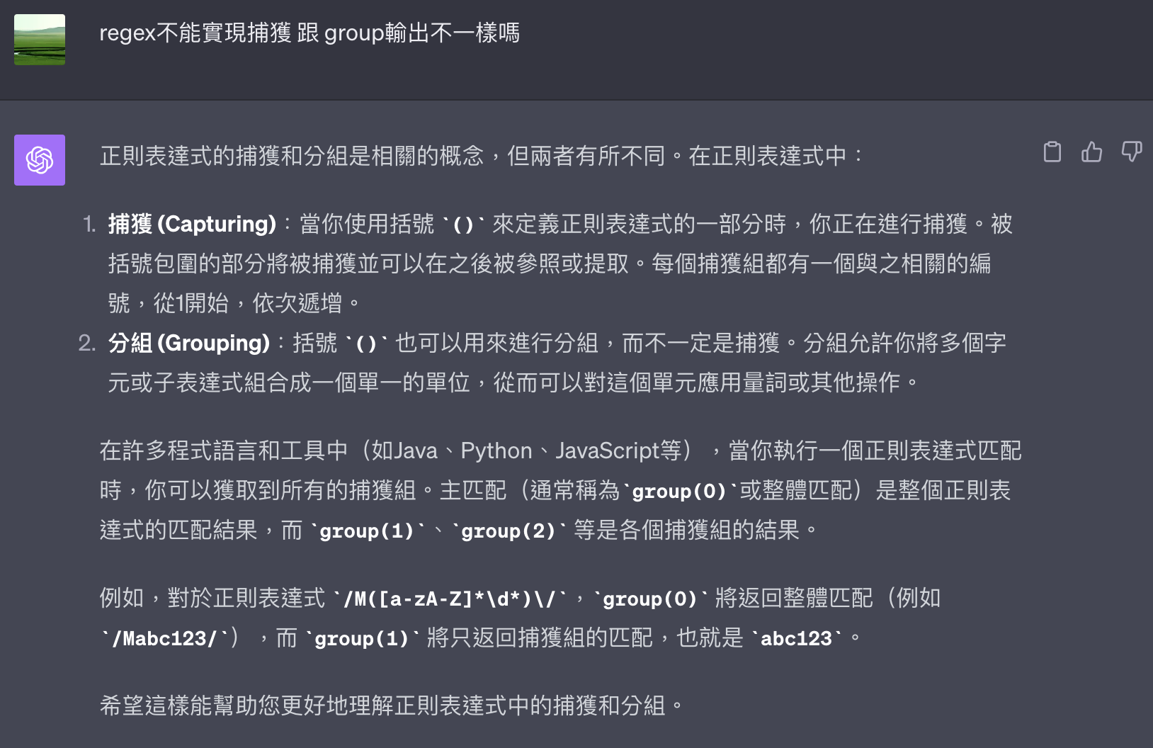
Ex3. Regex
/handshakewb|/M[A-Z]{4}\\d{3}/
replaceAll(“/”, “”);

Slide 15
Summarize
Understanding my communication and converting it into draft code
Analyzing the document and giving me some keyword.
A new approach to learning.

